Slide 1
Data mining project
By: Eric Ye
Instructor: Gitimoni Saikia
December 22, 2020
Metro College of Technology

Slide 2
Dataset 1 – Medical Costs
Based on medical insurance data for families
1338 observations, 7 variables
The goal of this analysis is to interpret and accurately predict factors impacting insurance costs

Slide 3
Variable Explanation
Age - age of the primary beneficiary
Sex - insurance contractor gender, female, male
BMI - Body mass index, providing an understanding of body, weights that are relatively high or low relative to height, objective index of body weight (kg / m ^ 2) using the ratio of height to weight, ideally 18.5 to 24.9
Children - Number of children covered by health insurance / Number of dependents
Smoker - Smoker or not
Region - the beneficiary's residential area in the US, northeast, southeast, southwest, northwest.
Charges - Individual medical costs billed by health insurance

Slide 4
Purpose Analysis
Main goal for analysis is to see how the variables predict and affect insurance charges
Data cleaning/ preprocessing
Export data
Model building
Linear regression model
R-sq, adjusted R-sq, RMSE
Correlation matrix, p-values

Slide 5
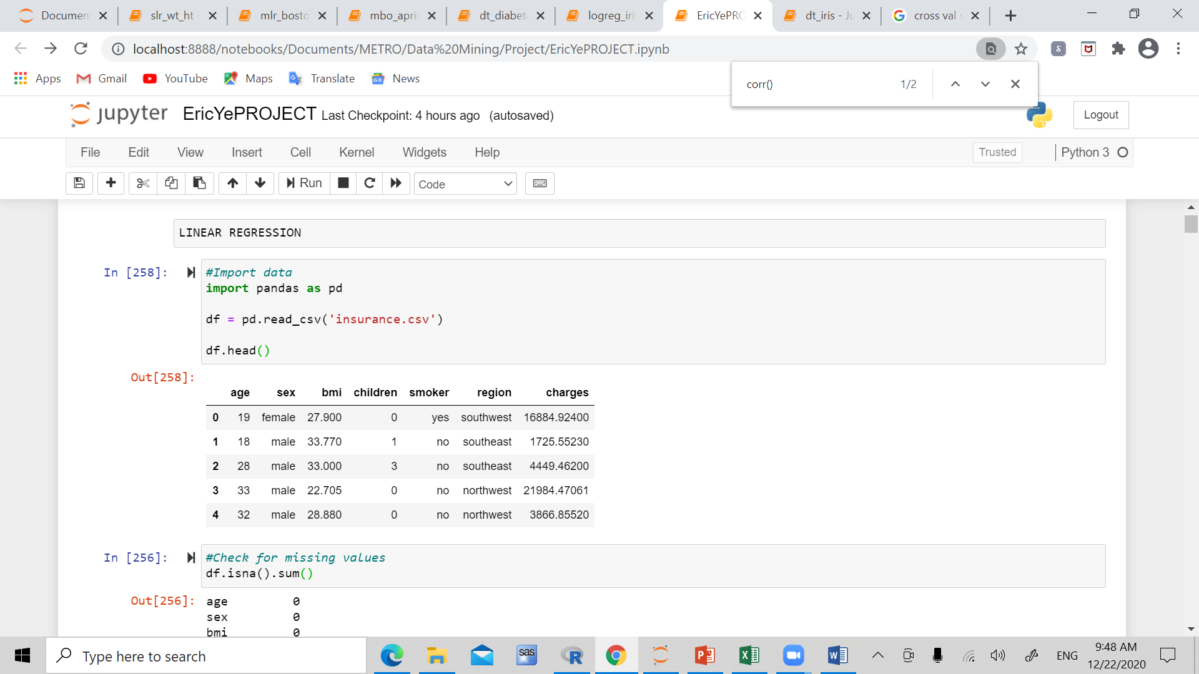
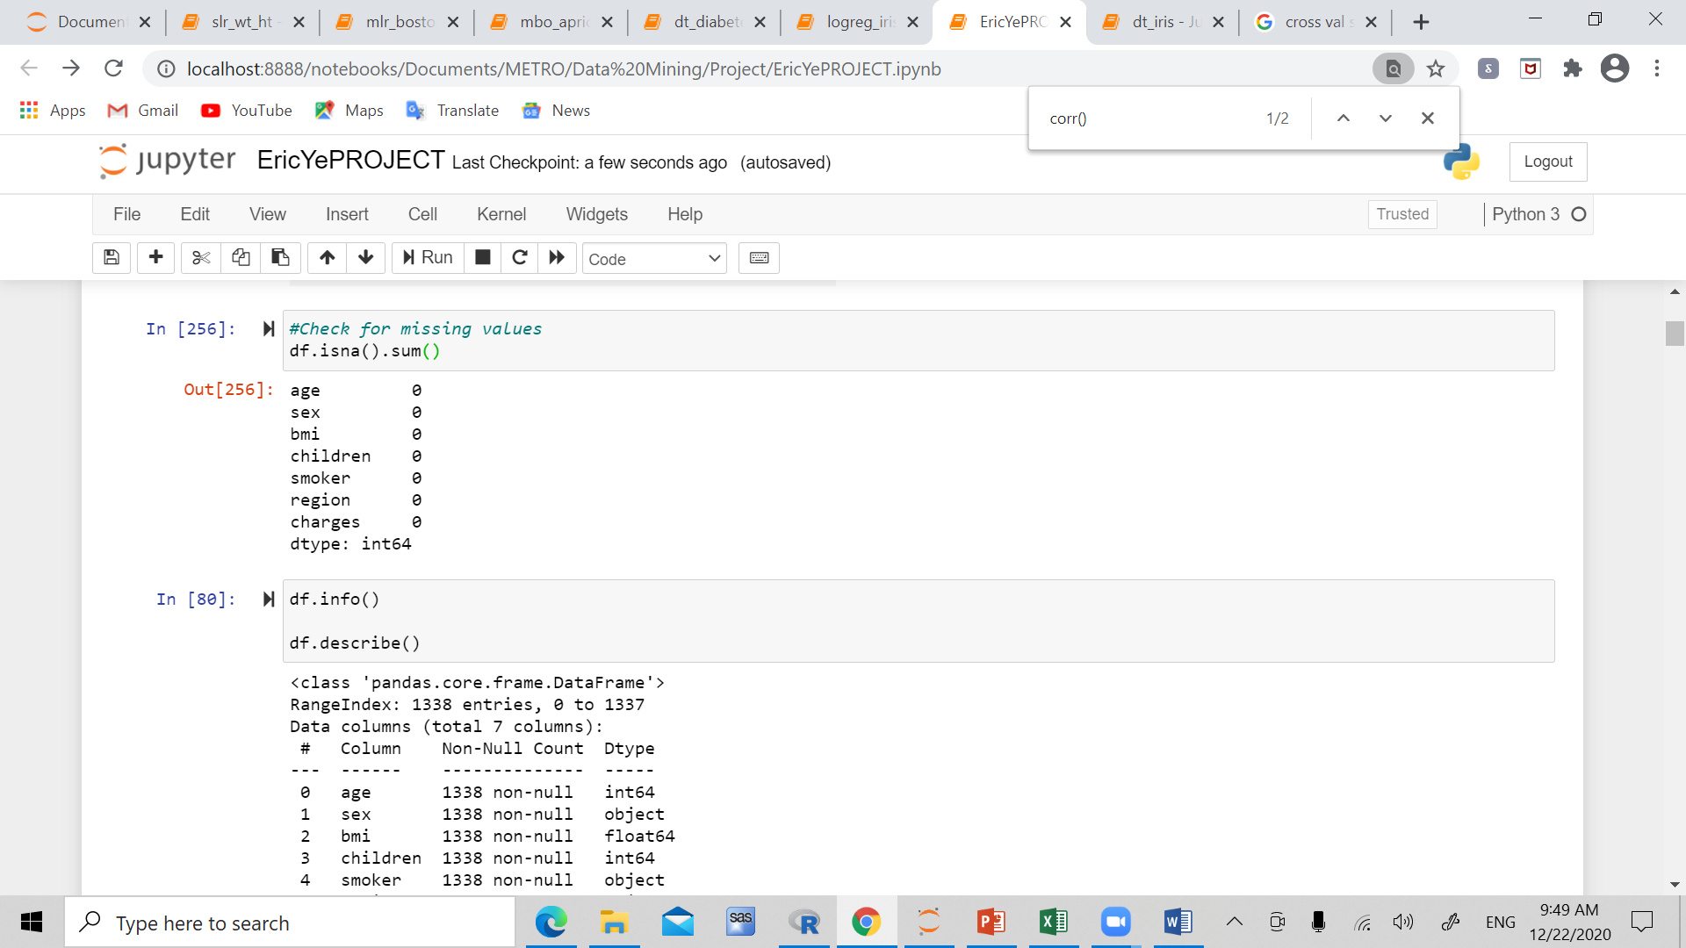
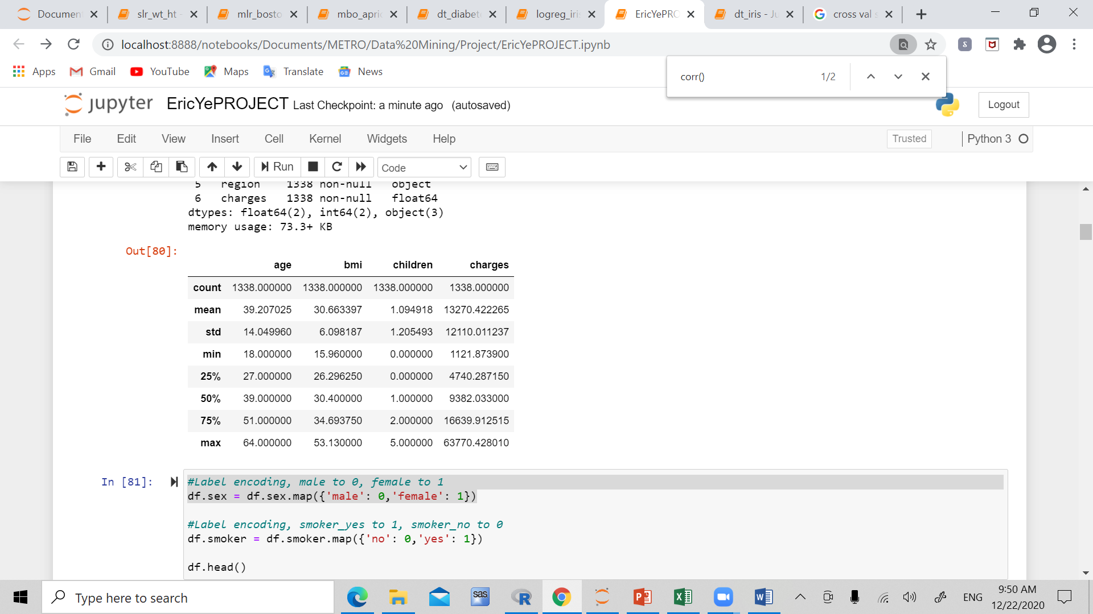
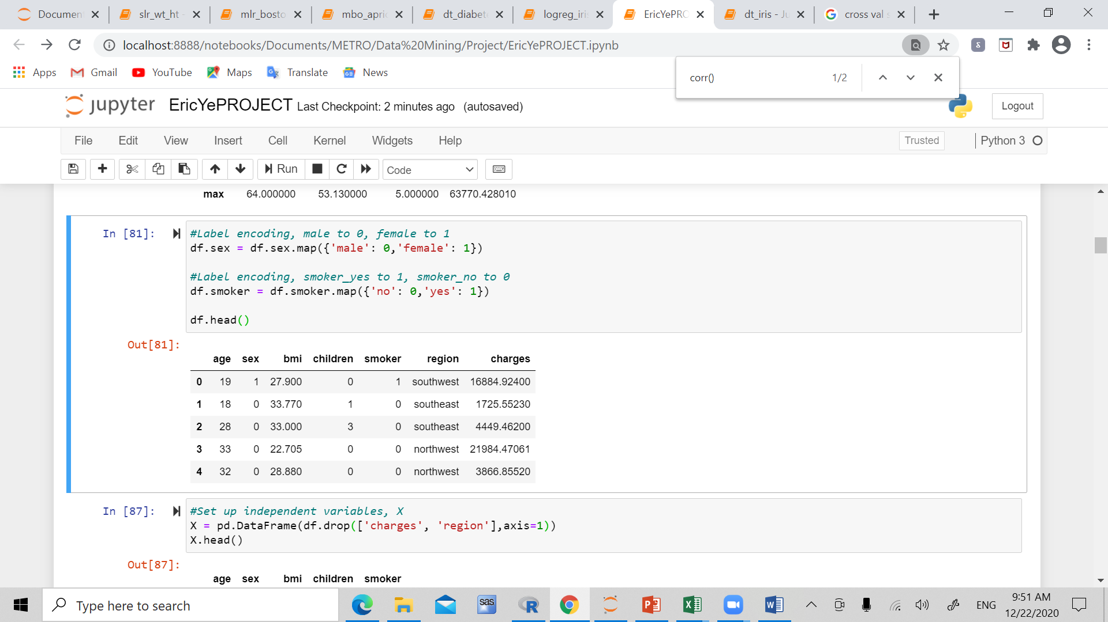
Description

Slide 6
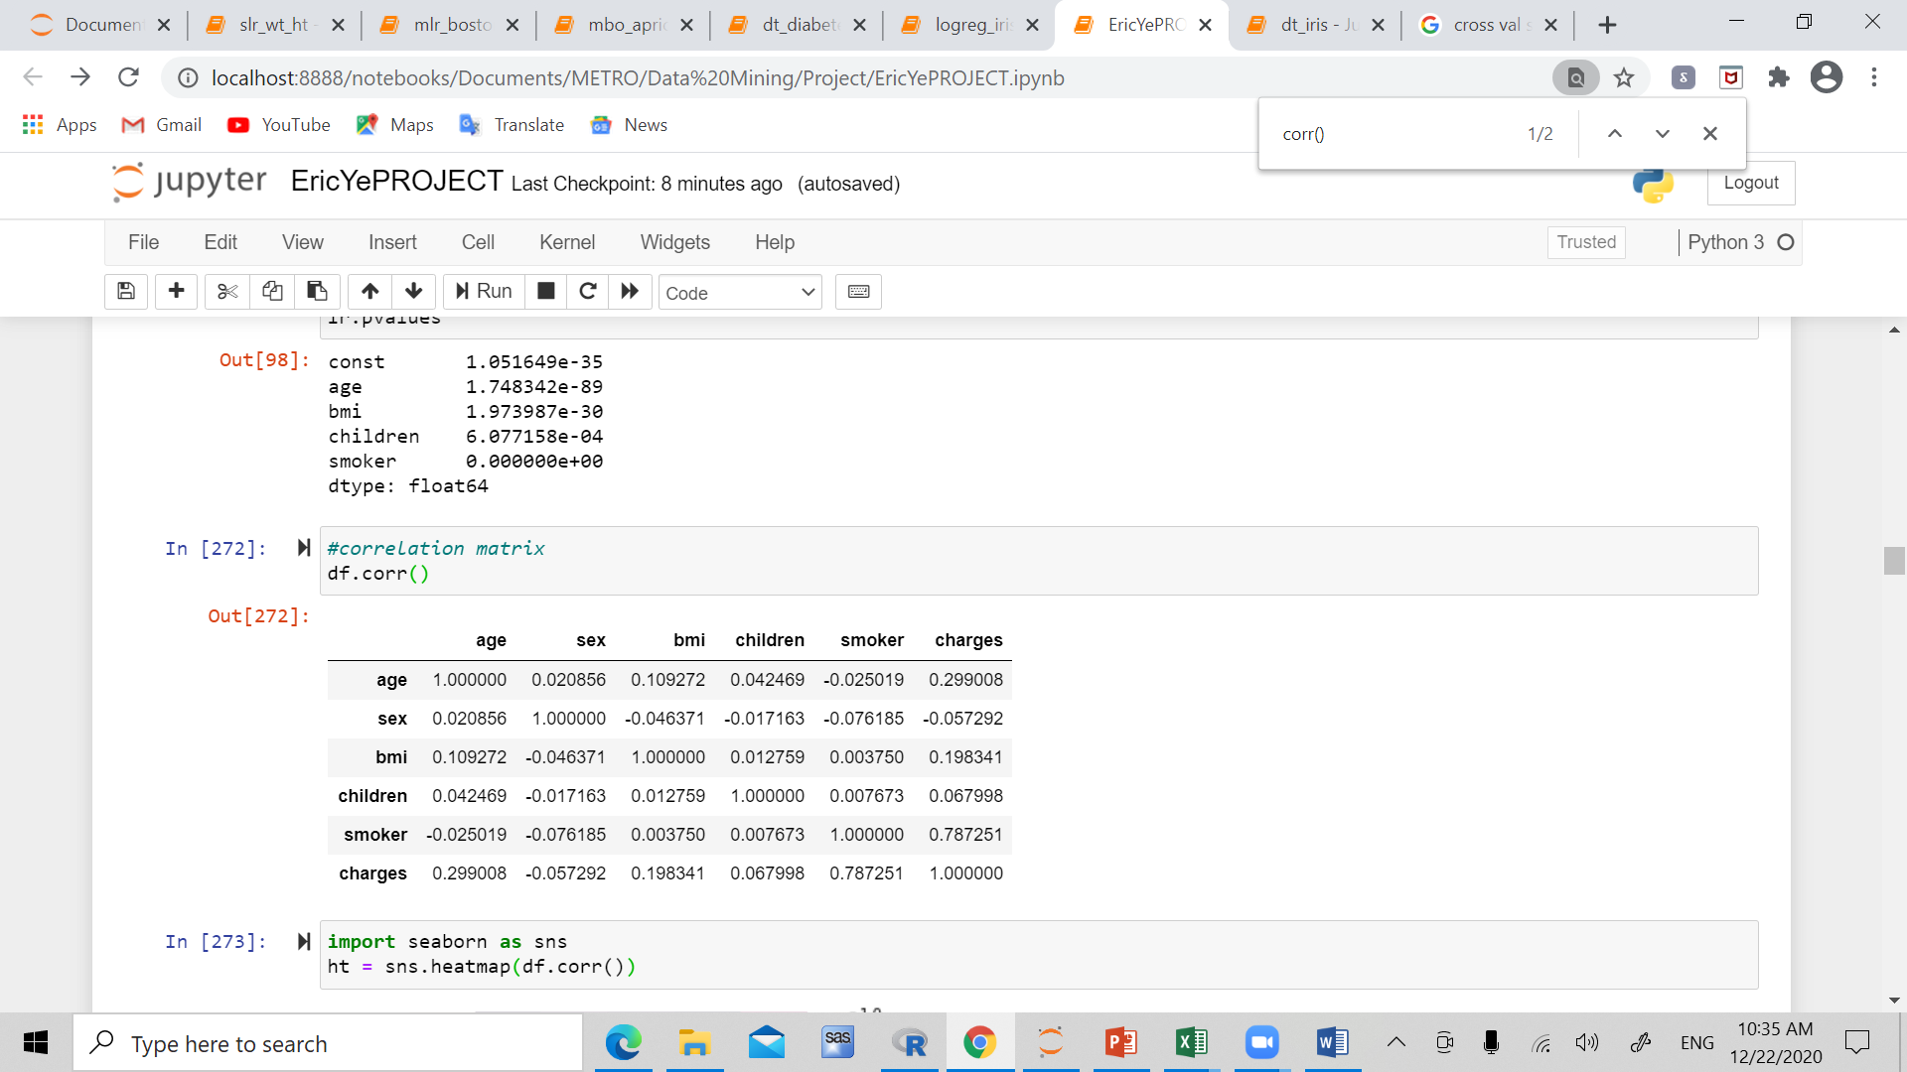
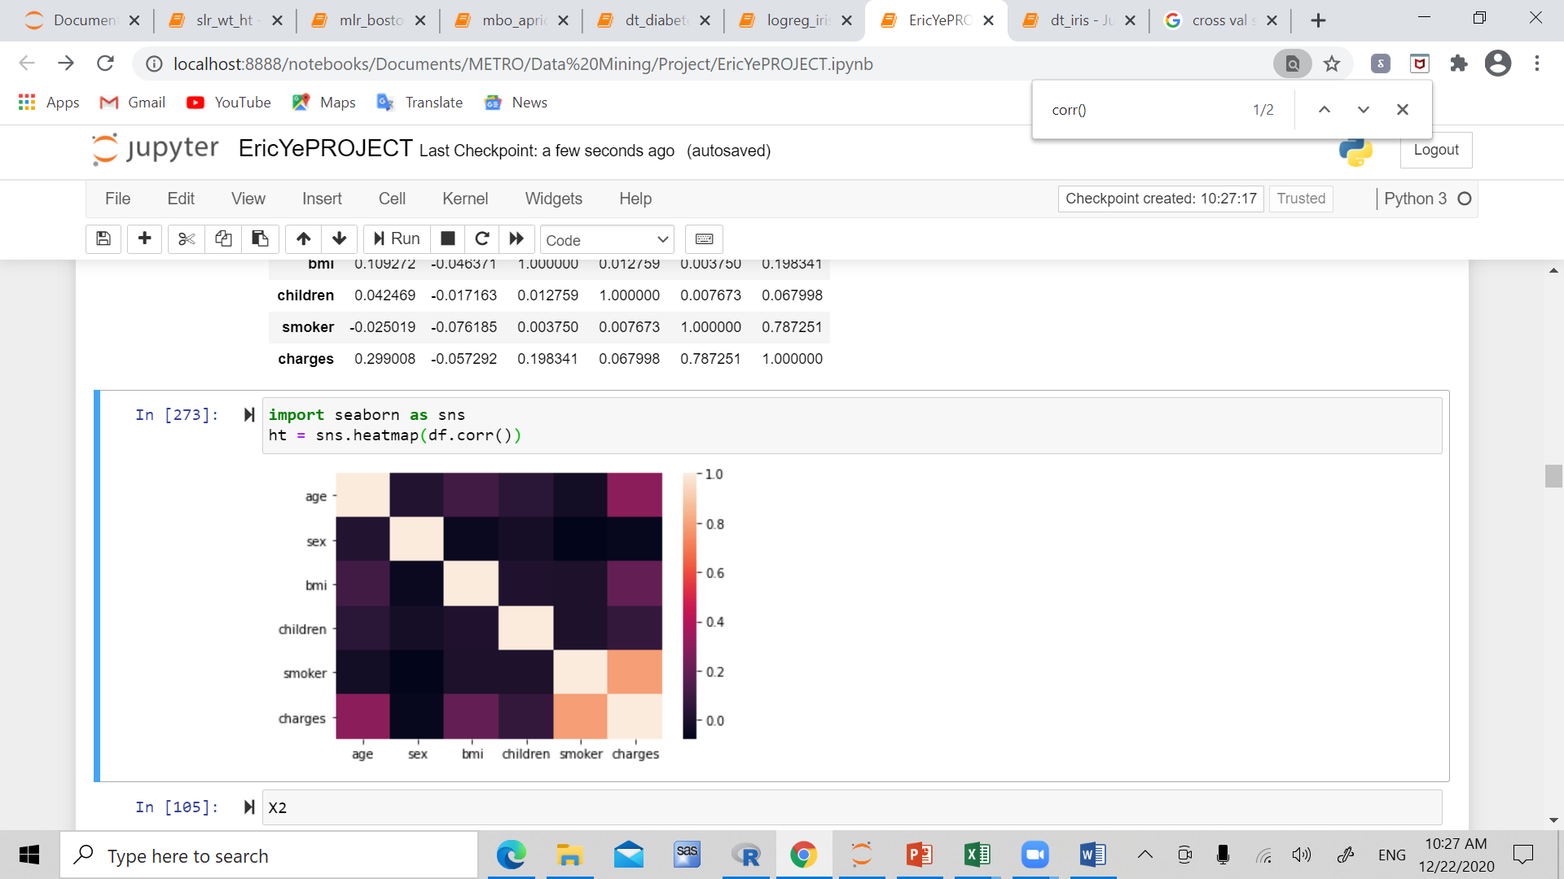
Correlation

Slide 7
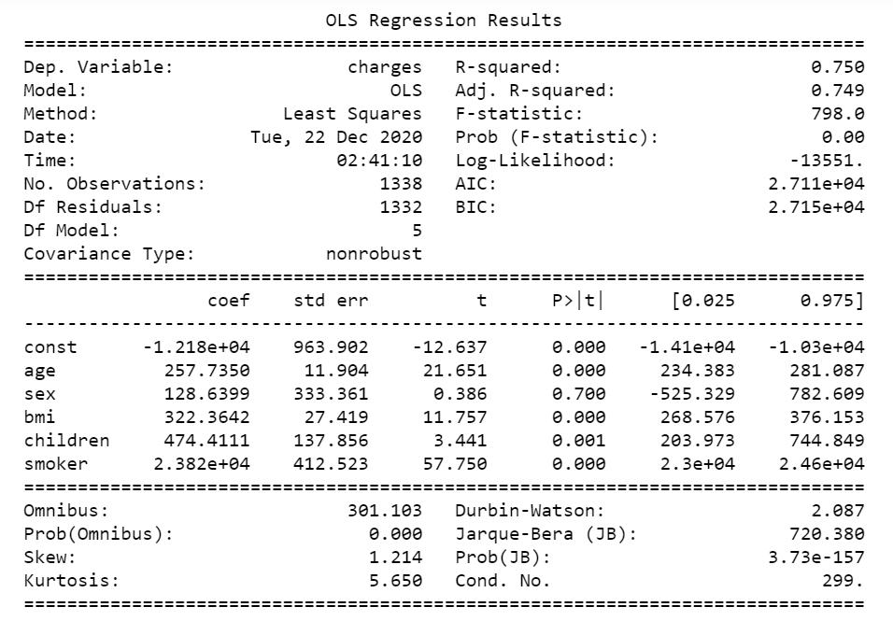

Slide 8
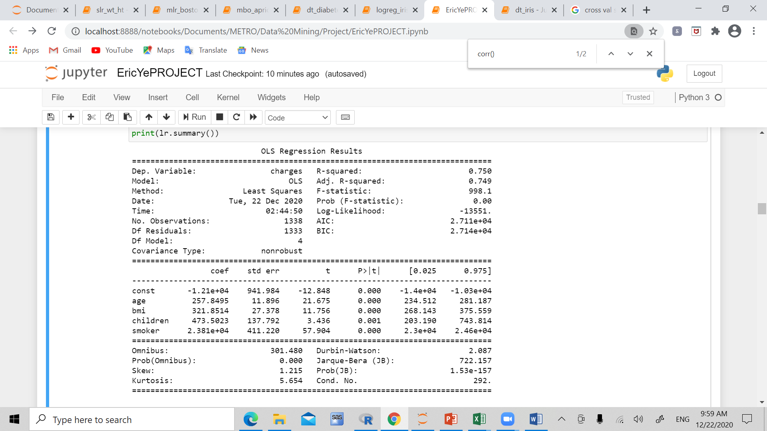
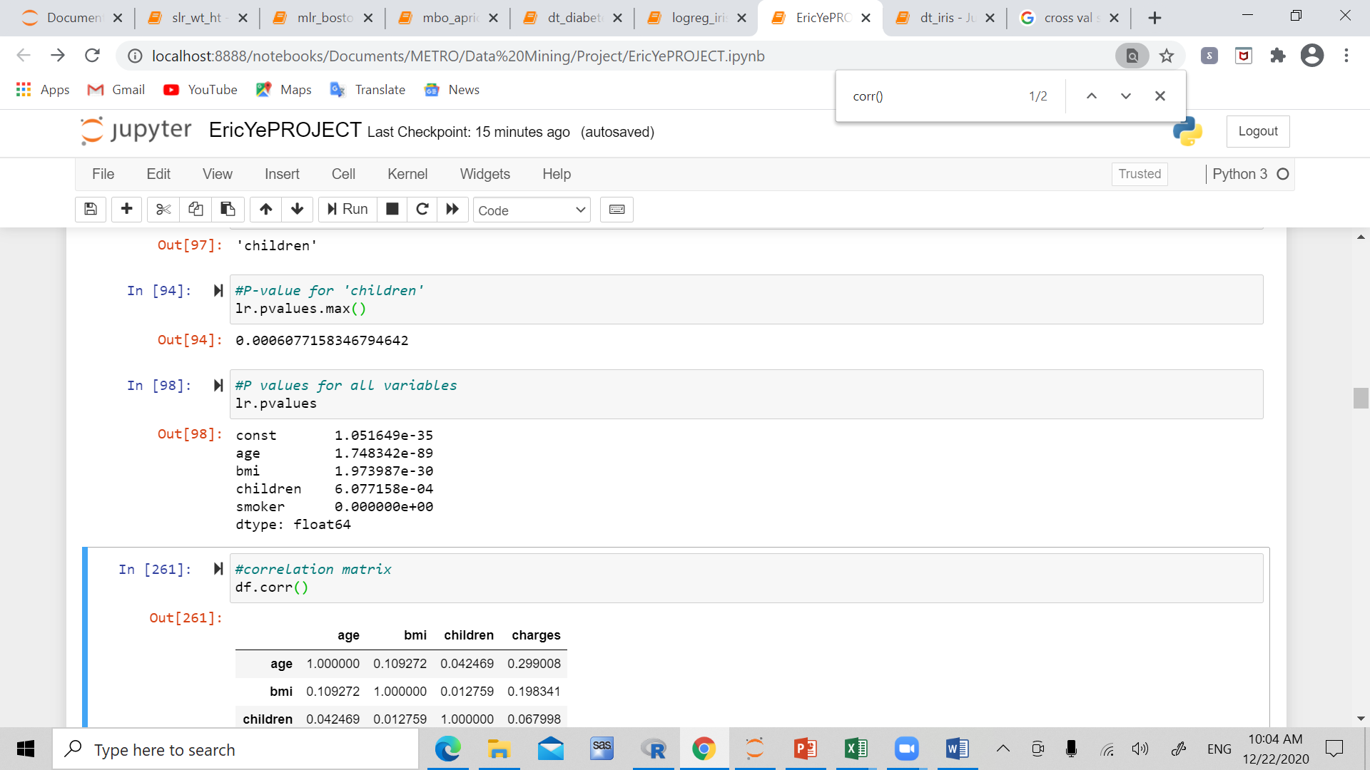

Slide 9
Cross_val: 0.7469266088
Model_score(X_test,y_test): 0.739197735
R^2: 0.739197735044
MSE: 36960029.27907
RMSE: 6079.47606945
Negative RMSE: -6072.42277
Adjusted R^2: 0.73657
Age, Bmi, children, smoker have most impact on charges

Slide 10
Dataset 2 – HR analytics
A large company XYZ, employs around 4000 employees, with around 15% leaving each year (attrition), bad for the company
4411 observations, 24 variables
Goal of the analysis is to perform logistic regression, and investigate the dependent variable Attrition.

Slide 11
Variable Explanation
Age – Age of employee
DistanceFromHome – distance employee lives from home
JobLevel – Job level at company on scale of 1-5
MonthlyIncome – income per month
Education – education level of employee, scale of 1-5, ‘below college’, ‘college’,’bachelor’,’master’,’doctorate’
NumCompaniesWorked
YearsAtCompany
YearsSinceLastPromotion
PercentSalaryHike – change in salary for last year
Attrition – whether the employee left in the last year

Slide 12
Purpose Analysis
The main goal in this analysis is to have an idea about the factors determining the attrition of employees
Data cleaning/ Missing value detection treatment/ Encoding
Select appropriate independent variables
Split dataset into X, Y
Import Learning Model
Run RFE and select best subset of X
Split into train and test sets
Find accuracy, recall, precision (Classification)

Slide 13
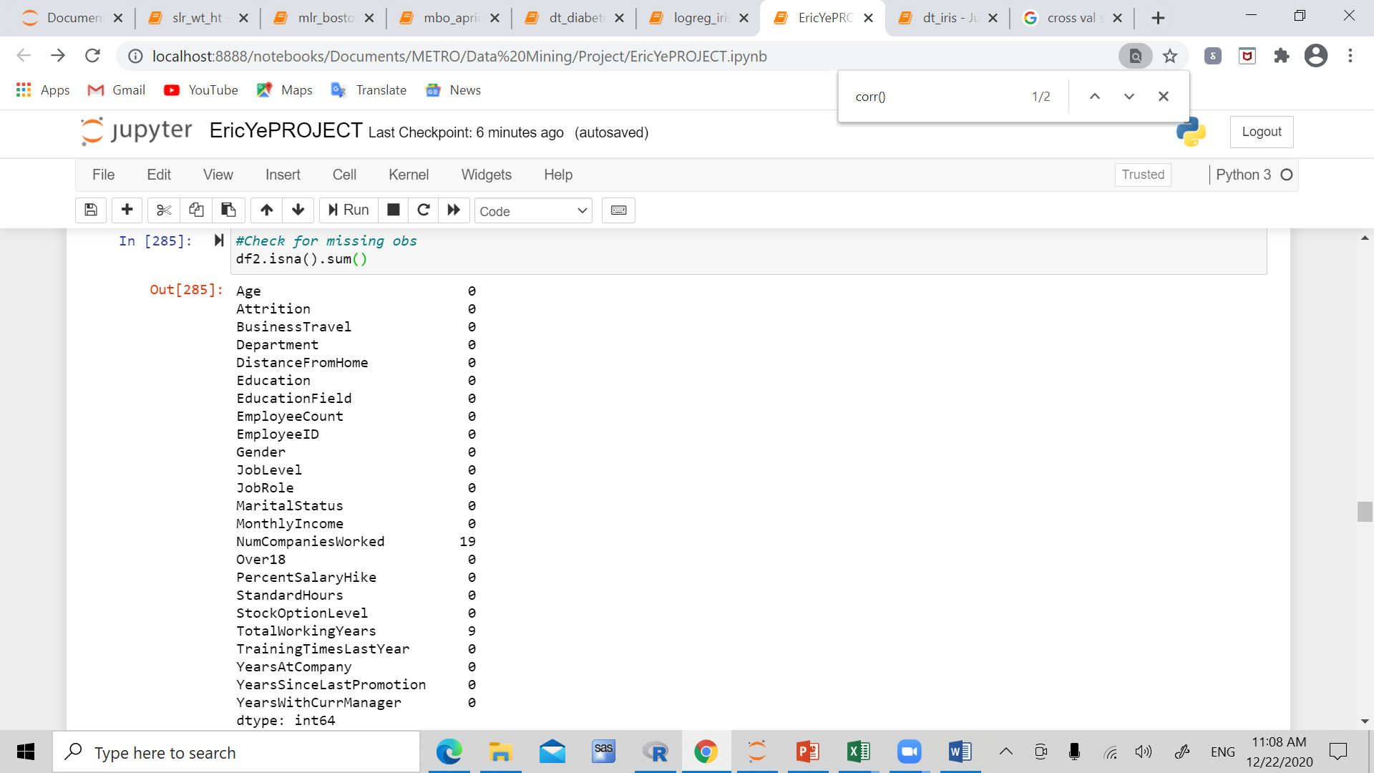
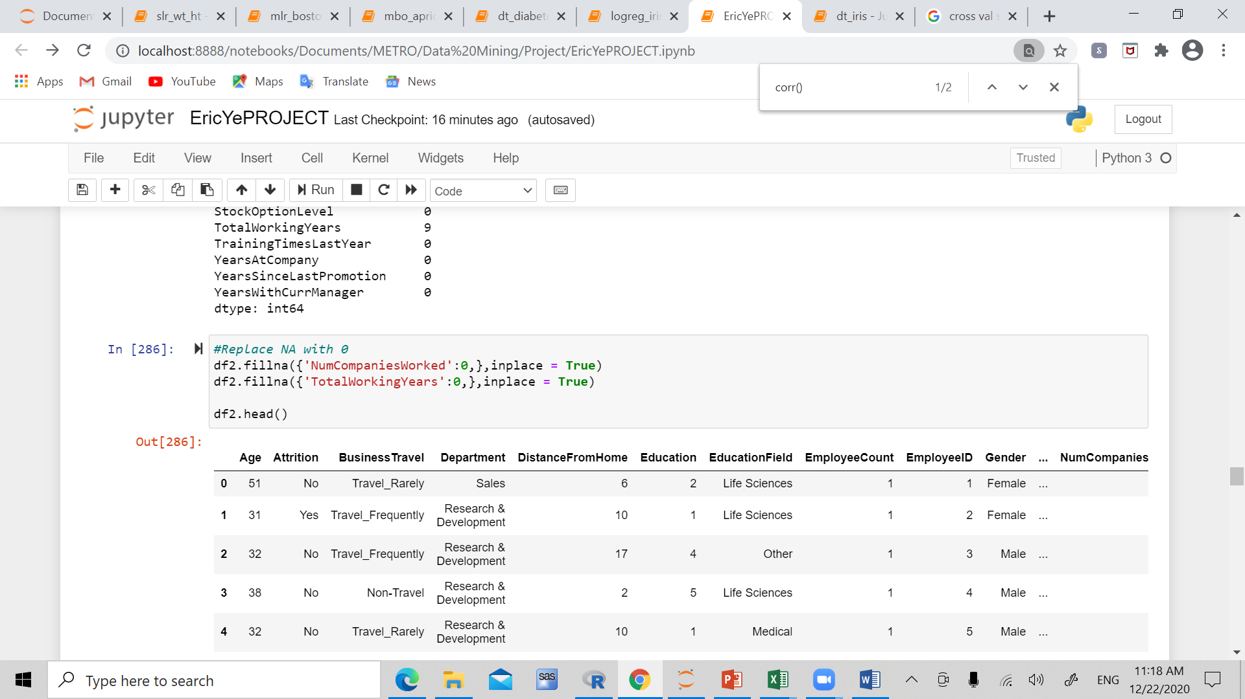
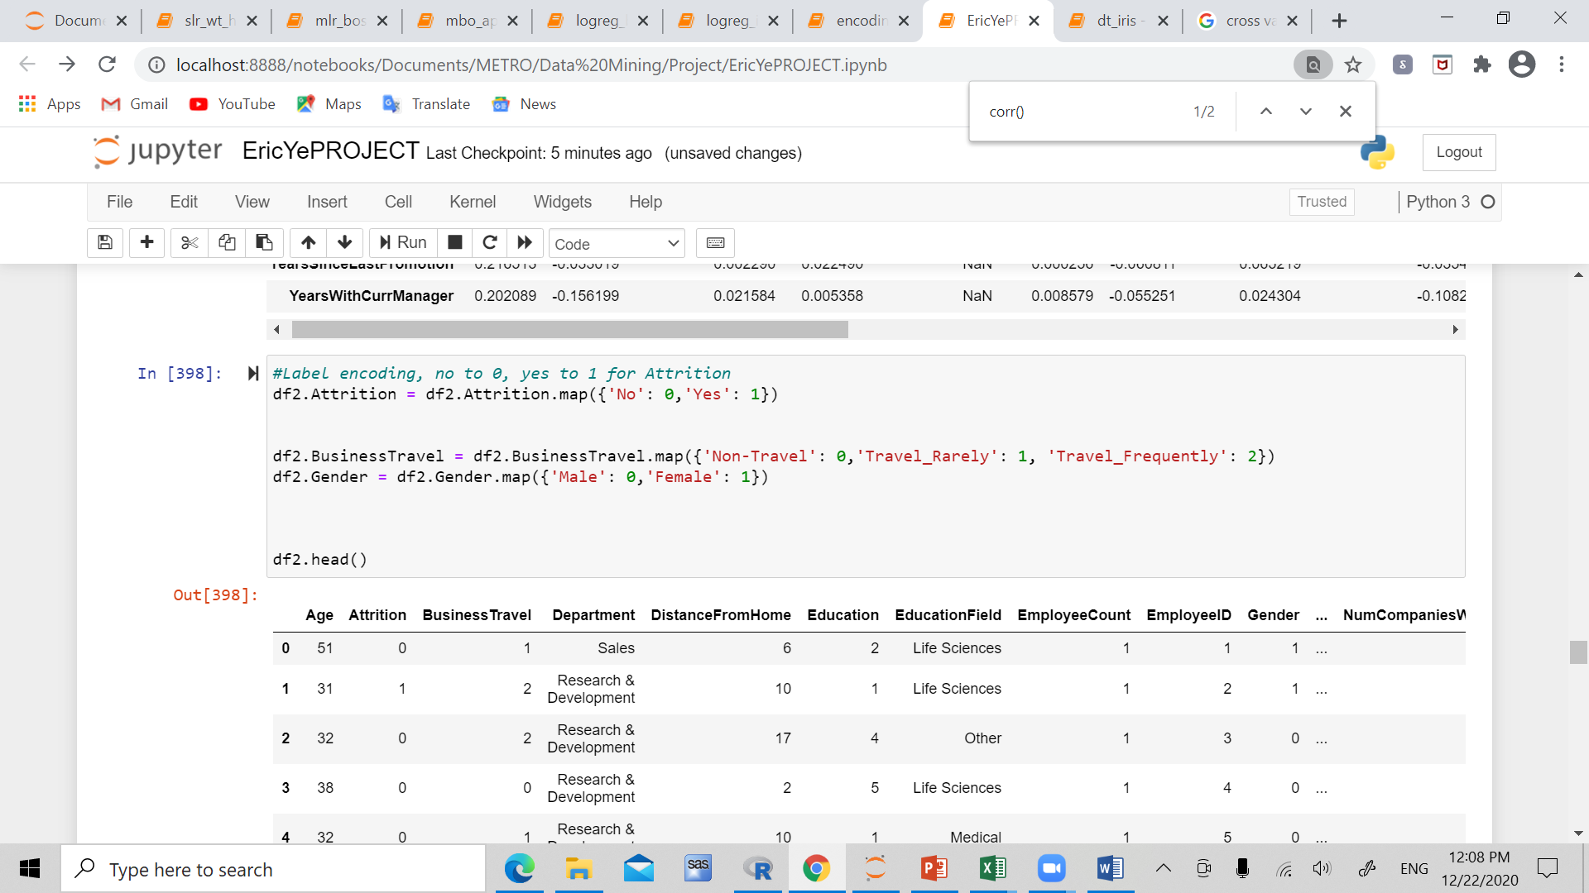
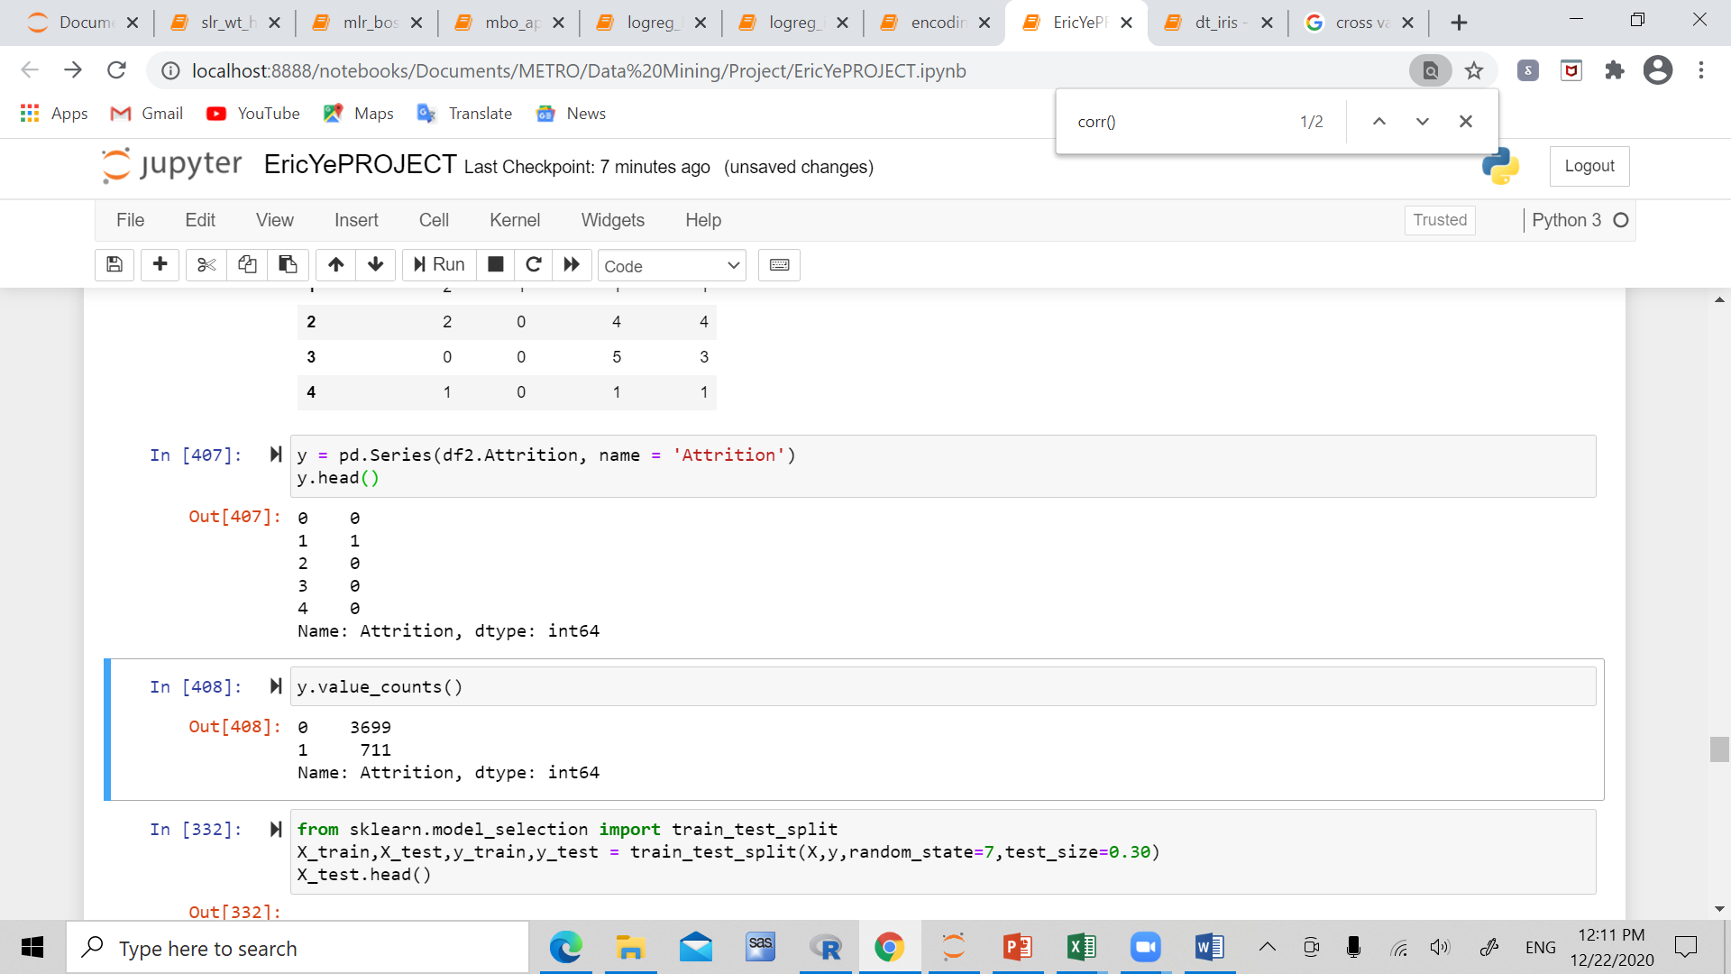
Cleaning

Slide 14
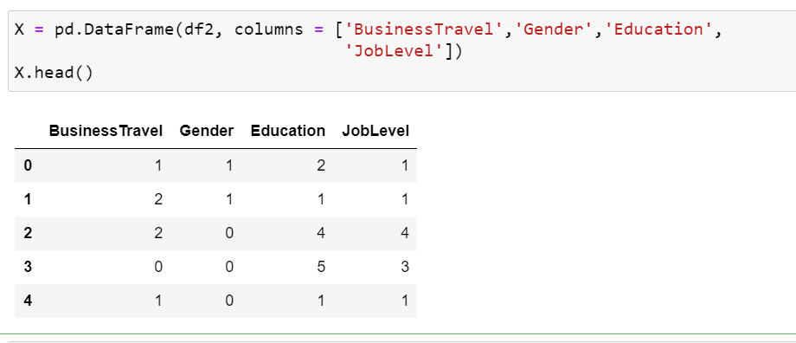
Select independent variables

Slide 15
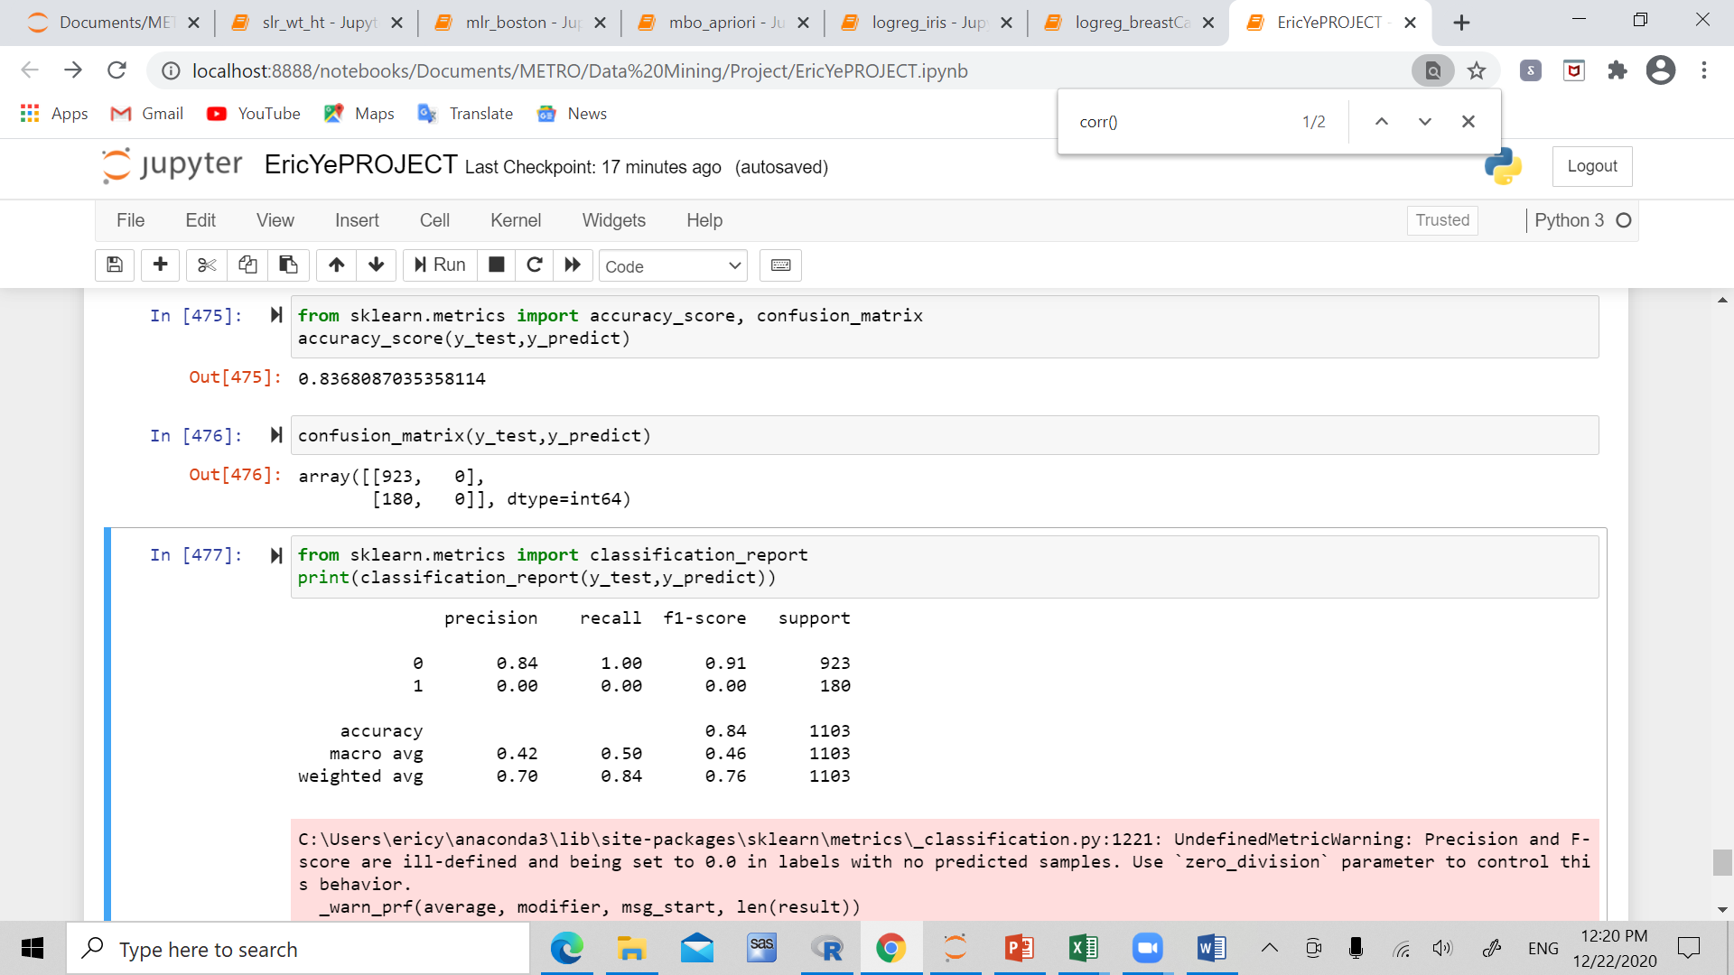
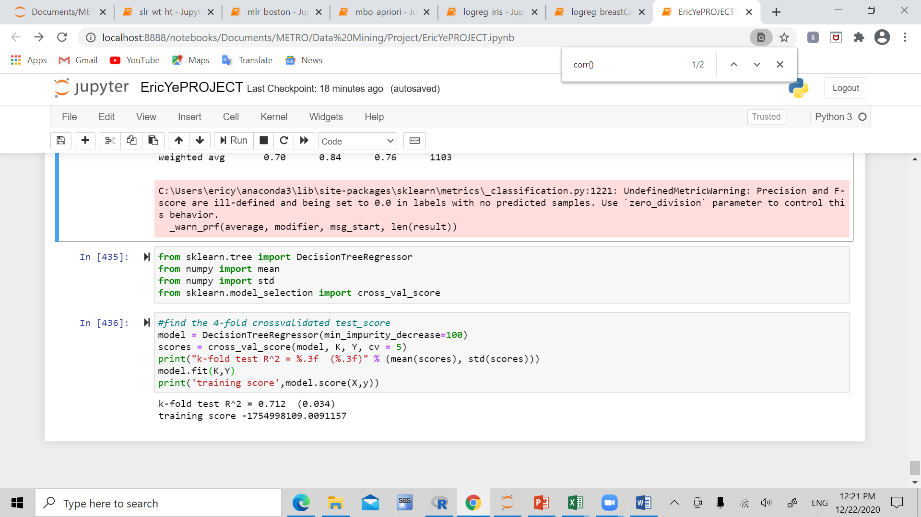
Confusion Matrix/ Accuracy

Slide 16
Thanks for listening!
Questions?
References:
HR Analytics Case Study | Kaggle
Medical Cost Personal Datasets | Kaggle

